Slide 1
Analyzing the Business Makeup of Areas in Chicago Most and Least Affected by COVID-19
Anthony Urgena
April 19, 2021

Slide 2
Introduction
Covid-19 has affected everyone in some way shape or form
Chicago has areas that have been affected more and less than others
We will be comparing by Zip Code:
Case Rate per 100K
Death Rate per 100K
Test Rate per 100K
Cluster analysis will be used to help compare and contrast different areas

Slide 3
Data
Data will be gathered from the City of Chicago data portal
GeoJson boundary file from the city will help visualize
Foursquare will be used to gather business data of Zip Code

Slide 4
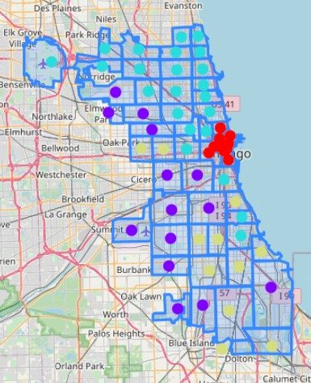
Clustering of the Businesses
Split in to 4 clusters
Split geographically
West (Cluster 1)
North (Cluster 2)
South (Cluster 3)
Central (Cluster 4)

Slide 5
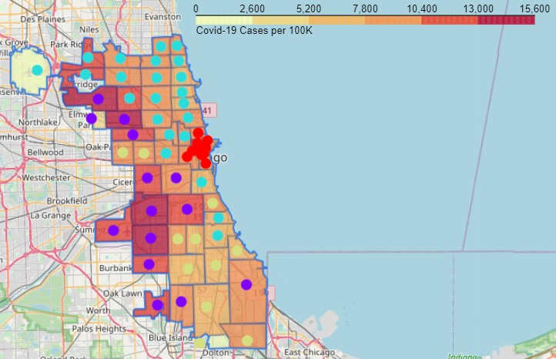
Cases per 100K with Clusters
Area in purple (Cluster 1) showing the darkest shading
Mexican restaurants were either first, second, or third most common venue

Slide 6
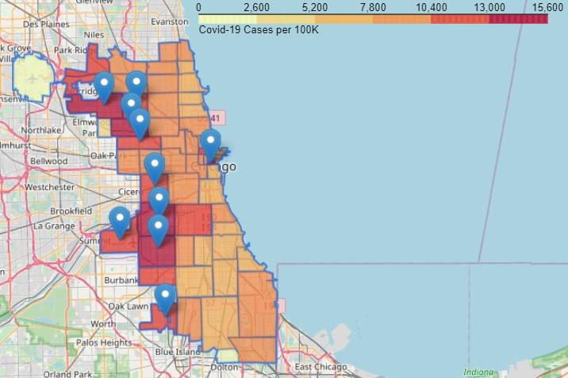
Cases per 100K with 10 Highest Rates
Mostly concentrated on the west side of the city
Outlier in central area
Lower population so number might be skewed

Slide 7
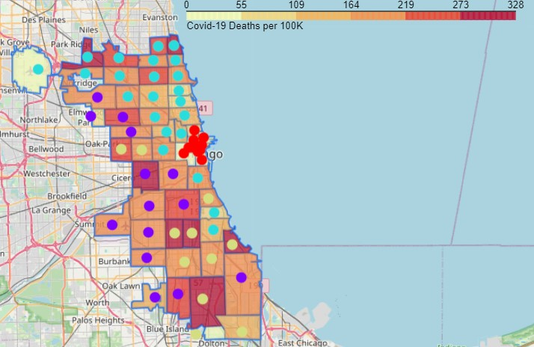
Deaths per 100K with Clusters
No clear cluster associated with darker shadings
Different data (socioeconomic or other access to health care) may be needed to find a connection

Slide 8
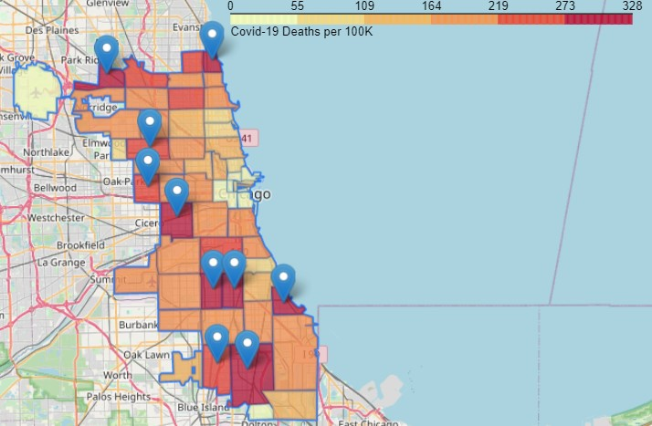
Deaths per 100K with 10 Highest Rates
No apparent pattern besides not centrally located
Like in previous slide different data may be needed to find a connection

Slide 9
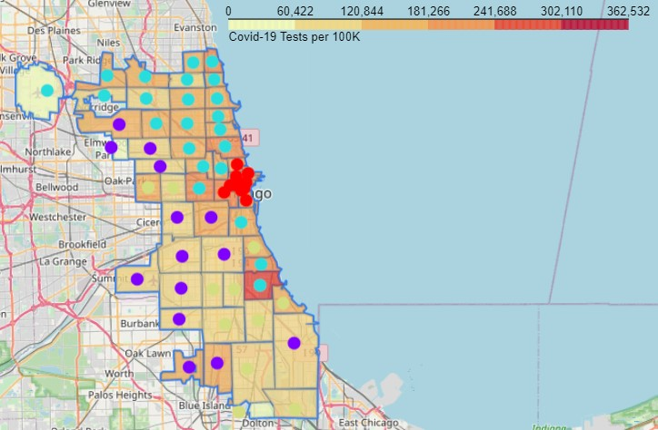
Tests per 100K with Clusters
No apparent pattern in terms of testing distribution

Slide 10
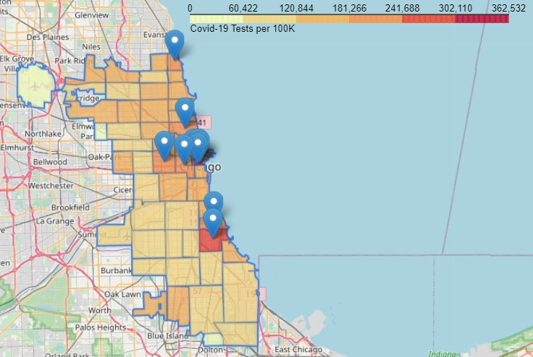
Tests per 100K with 10 Highest Rates
Concentrated centrally
Outlier in the north and two to the south
These areas may be the most accessible where other areas may not
More of the population in these areas willing to test

Slide 11
Conclusion and Future Directions
Clustering of businesses can help determine how similar areas are
Comparing clusters to case rate shows clearly affected area in West side of city
Other data would be needed to research further for death and test rates
Maps with the clusters can help visualize where more resources are needed

